Slide 1
Unusual Event Detection from
surveillance video shots
Day 2
Organisation: Department of Science and Technology
College: National Institute of Technology, Warangal

Slide 2
Work done on Day 1
Downloaded dataset of 9.5 GB
Made a simple UI (which will be improved further)
Extracting frames from videos to feed into the model.
Partially coded ML model and backend of Web App

Slide 3
Work Done after yesterday’s feedback
Implemented the ML backend using 3D CNN
Trained the model on the dataset available and found accuracy
Improved the web app from yesterday and integrated the the ML backend
Tested the entire framework on an end-to-end basis(input the video, output the timings)

Slide 4
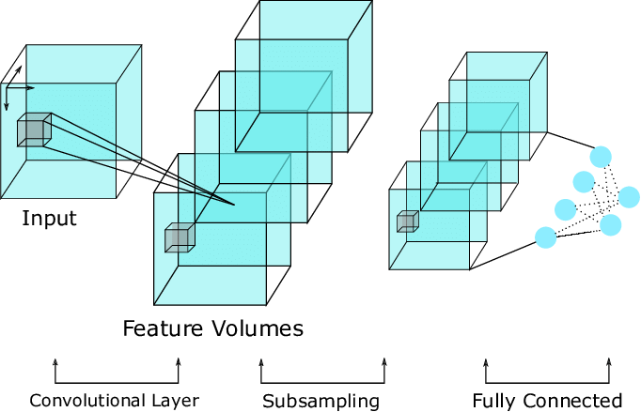
3DCNN

Slide 5
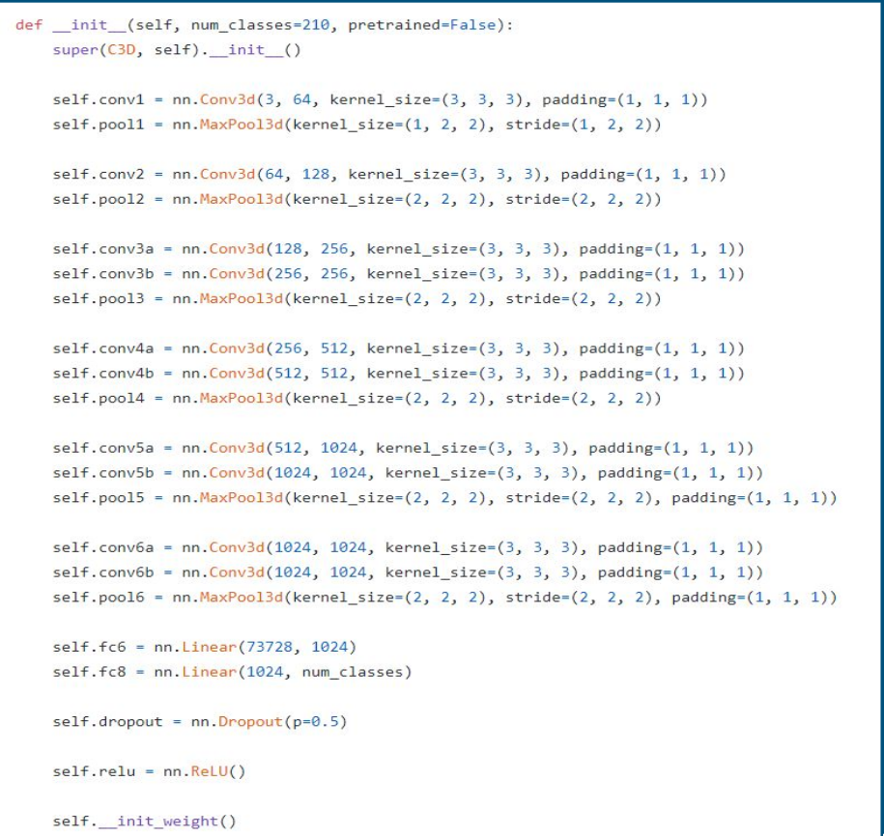
Model Architecture

Slide 6
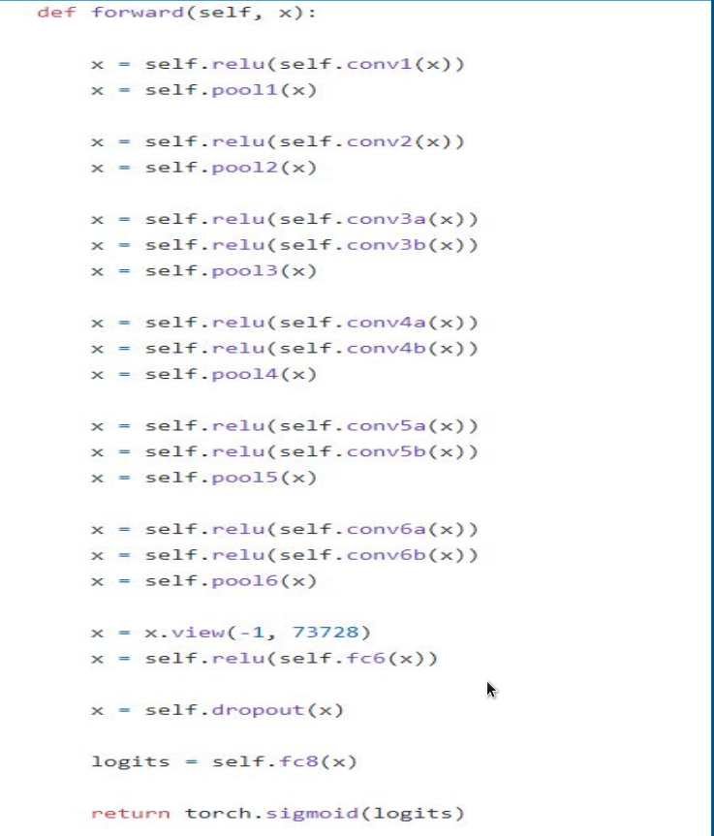

Slide 7
Future Plan of action
Adding alert system (SMS)
Adding the Maps API

Slide 8
Demo

Slide 9
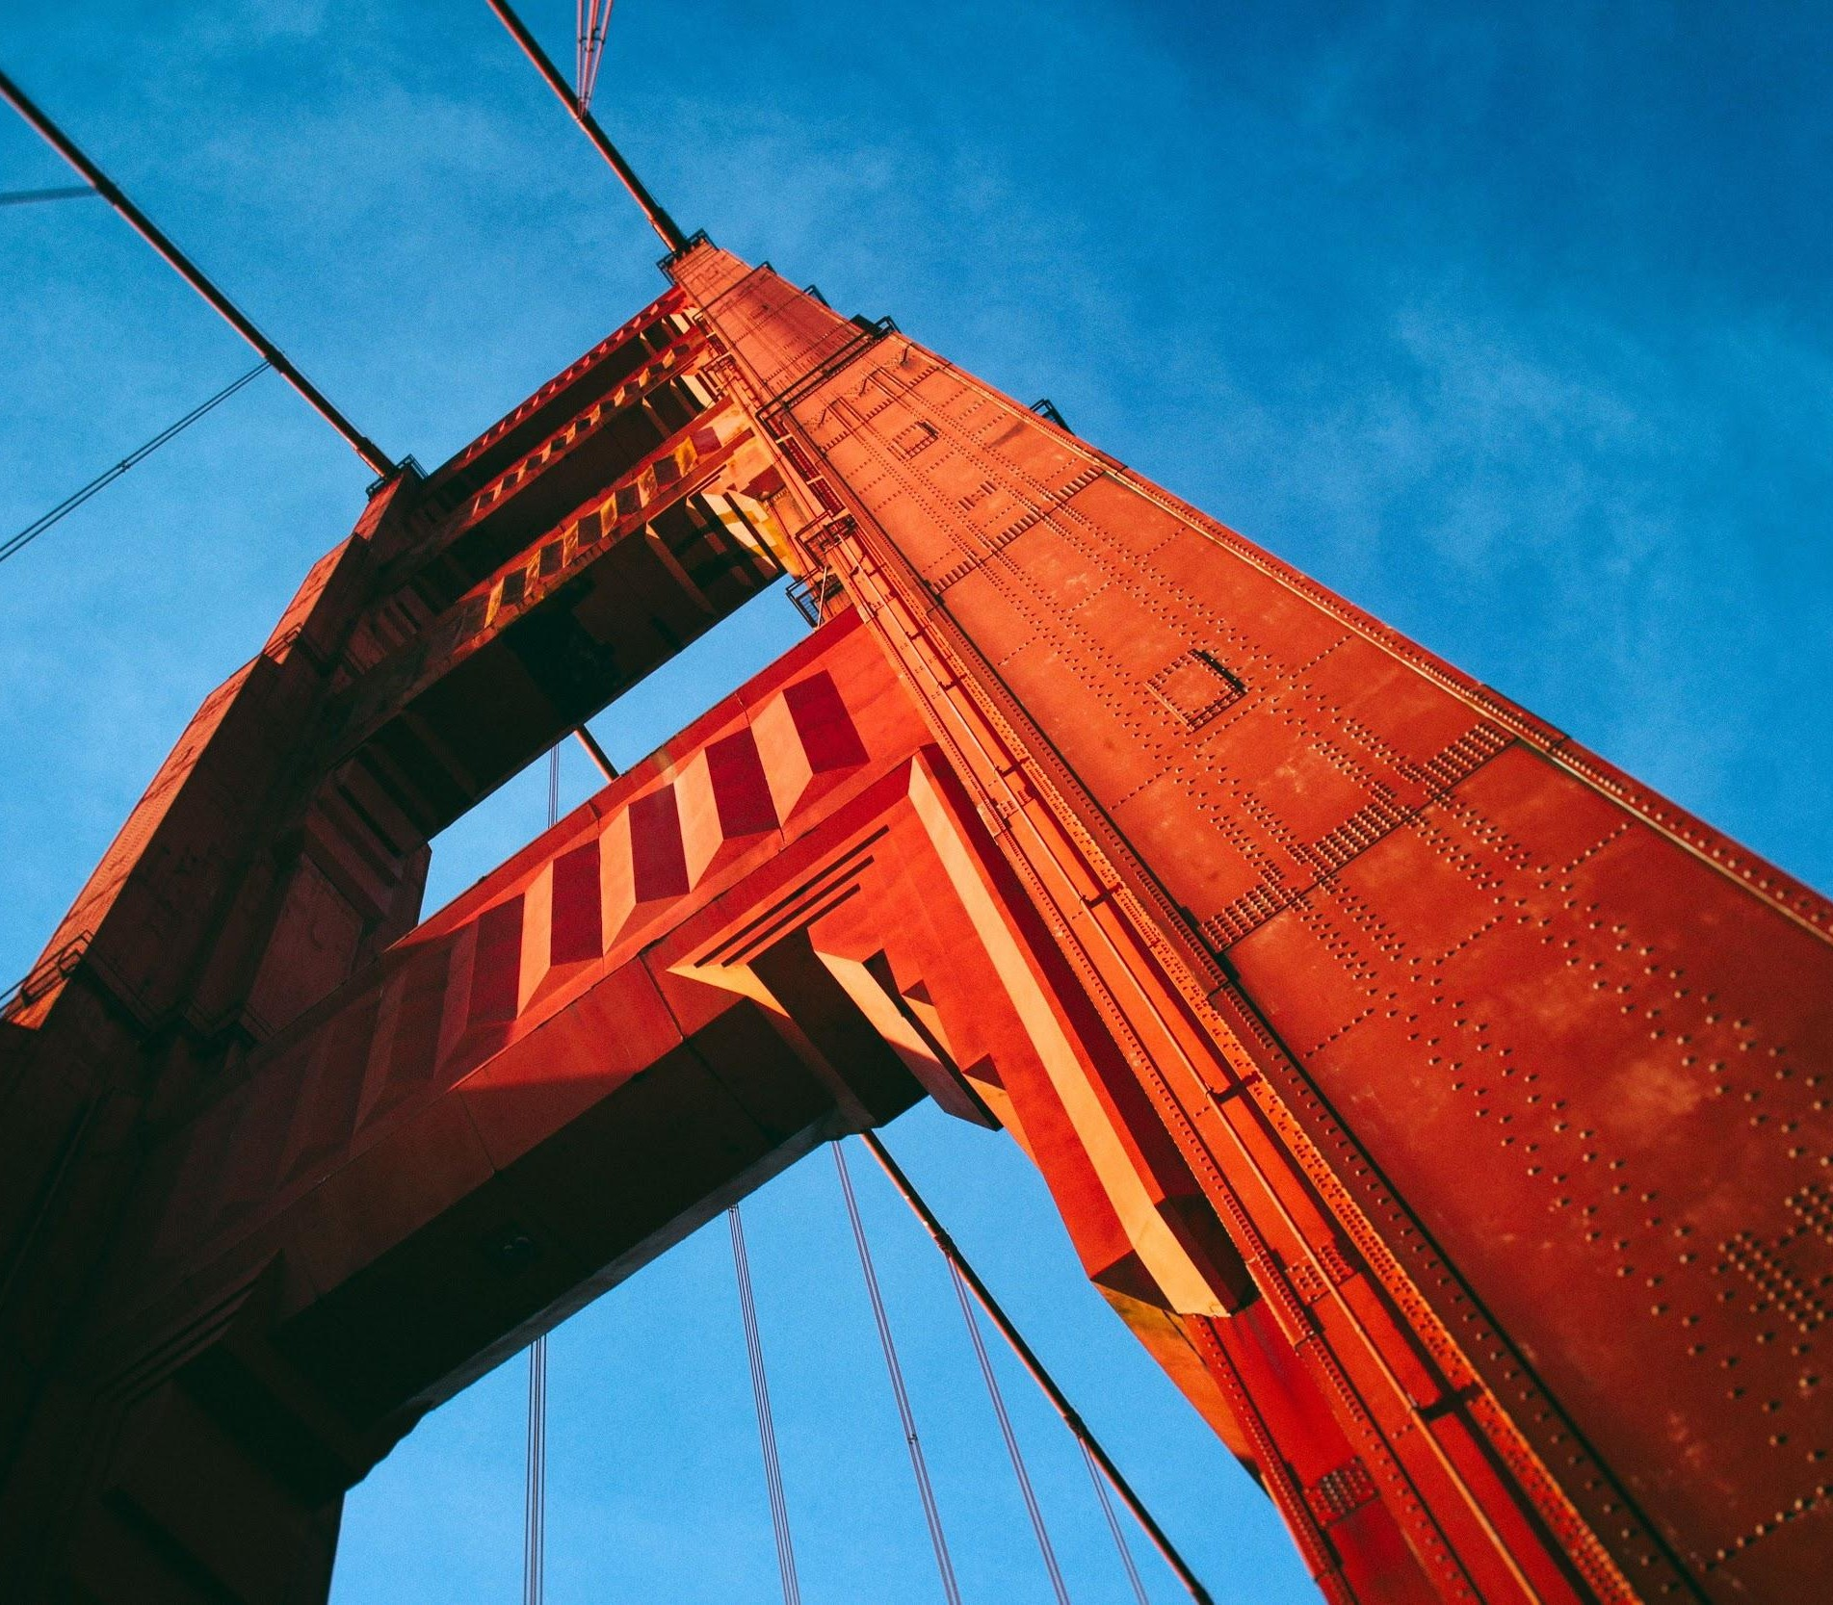
Thank You
Team Traﬃx NIT Warangal Telangana, India

